Slide 1
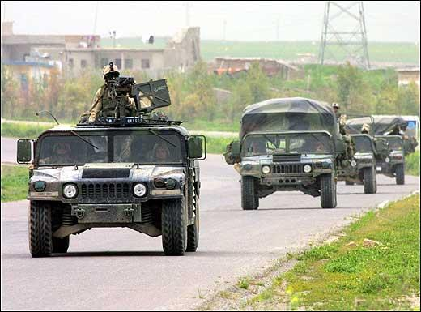

Convoy Operations

Slide 2
PURPOSE
The purpose of this brief is to provide deploying leaders information on tactical convoys with special emphasis on current enemy TTPs

Slide 3
AGENDA
Convoy organization
Convoy planning
Tactical convoy defensive measures
Theater TTPs

Slide 4
CONVOY
Column of vehicles that moves from the same origin to destination and is organized for the purpose of control under a single commander.
Minimum number is directed by commands.

Slide 5
CONVOY ORGANIZATION
Include march units, serials, and columns.
March unit- smallest element of a convoy. As
the smallest subdivision of a column, march units
usually represents a squad to platoon size element.
Each march unit has a commander.
Serial- group of two to five march units.
Represents approx. a company to battalion size
element. Each has a commander.

Slide 6
CONVOY ORGANIZATION
Columns- Group of two to five serials. Represents
approximately a battalion- to brigade-size element.
Each column has a column commander.
Convoy commanders should not generally subdivide
march units of 20 or fewer vehicles into smaller march
units because of road space considerations.

Slide 7
CONVOY ORGANIZATION
March
Unit
March
Unit
March
Unit
March
Unit
SERIAL
SERIAL
MARCH COLUMN

Slide 8
CONVOY FUNCTIONAL
ELEMENTS
HEAD
TRAIL
MAIN BODY

Slide 9
VEHICLE PLACEMENT
  Give special attention to vehicles loaded with
  ammunition and bulk petroleum. Separate these
  vehicles or disperse them throughout the march
  elements. A larger gap between vehicles carrying
  ammunition or bulk petroleum can be prescribed.
  Position heavier/slower vehicles at the head to
  assist in maintaining the prescribed convoy
  speed.
  Place C2 vehicles where they can maintain convoy
  control.

Slide 10
VEHICLE PLACEMENT
Place maintenance/recovery vehicles at the end
of the march unit and at the end of the convoy to
recover or make quick repairs to disabled vehicles.
When it will not compromise convoy security, locate
trucks requiring the longest unloading time at the
head of the march element for fast turnaround time.

Slide 11
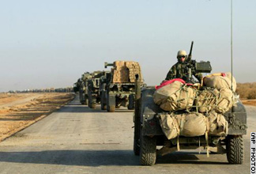
GUNTRUCK
Place where it can best provide needed firepower
Must have commo to be effective
1 per eight vehicles is recommended
Test fire prior to departure (are your crews familiarized with firing from vehicle platform and on the move)
Thoroughly briefed and thoroughly rehearsed
Notes:
NEXT: RAT PATROL

Slide 12
GUN TRUCK PLACEMENT
HALTED
TRAVELING
GUN TRUCK PLACEMENT
Gun trucks are predominantly ring mounted 5 ton vehicles with an M-2 or M-249 machine gun attached. These weapons are placed at the front, rear and staggered within the convoy. When traveling gun trucks are directed toward “hot spots”. When halted the front and rear gun trucks protect the head and tail of the convoy. Remaining gun trucks are positioned to mutually protect the convoy flanks.
1
1
2
2
3
3
HOT
SPOT
4
4
5
5
7
7
6
6
7
7

Slide 13
TYPES OF COLUMN
FORMATIONS
Column must be organized to meet mission
requirements and ensure organizational control.
The convoy commander decides how the column
is organized for control. Three basic methods-
        Close column.
        Open column.
        Infiltration.

Slide 14
PLANNING FACTORS
Besides convoy control and organization,
convoy commanders must consider-
  Advance/quartering parties.
  Convoy control personnel.
  Start points (SP) and release points (RP).
  Halts.
  Gaps and march rate.
  Communications.
  Route reconnaissance.
  Escort/security elements.
  Convoy support.

Slide 15
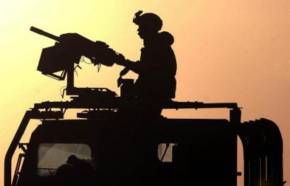
PLANNING CONSIDERATIONS
Recovery
Ambulance/medical coverage dispersed throughout convoy
Rest Plan
Disperse commodities
Convoy signals
Trail Party Assault Element
Security to prevent pilfering
Dispersion of key personnel
Window screens to deflect grenades
Drivers familiarized with hardened vehicle driving conditions
Notes:
AMBULANCES HAVE RADIOS
REST PLAN
NEXT: BRIEFINGS

Slide 16
PLANNING CONSIDERATIONS
Est. phase lines/checkpoints
Civilian considerations
Enemy threat capabilities, trends
Recon (air is preferred)
Closure report at destination and return
Deception plan
Air guard
Air cover
En route target reference points
Convoy signals
MP, IN, EN, ADA escort
Notes:
AMBULANCES HAVE RADIOS
REST PLAN
NEXT: BRIEFINGS

Slide 17
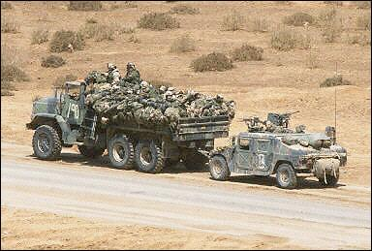
COORDINATION
Confirm radio freq, call sign, signals
Link-up points
Link-up procedures
Battle hand-off procedures
Information transfer procedures
Refuel sites
Escort coordination
Indirect fire coordination
Notes:
WHEN QRF, MP, OR TCF IS AVAILABLE
NEXT: ASST CONVOY CDR-NCO BUSINESS

Slide 18
CONVOY EXECUTION MATRIX
Given to every driver
Contains
  Mission
  Frequencies/Points of Contact
  Timeline
  Detailed Strip Map
  Enemy Situation
  Check Points, Release Points, Rally Points
  Everything needed to complete the mission
  Manifest-personnel, supplies, sensitive items
Notes:
ALL DETAILS NEEDED TO COMPLETE THE MISSION
MUST GO OUT 48+ HOURS
OPSEC, DTY IF ENEMY ACTION
MANIFEST- BACK SIDE, ONLY TO HIGHER
NEXT: RECON

Slide 19
STAGE/PCIs
Line up all vehicles in order of march
Conduct individual PCIs (equipment, license)
Conduct convoy/equipment PCI (BII, CEM, supplies, goggles)
Mechanic assists with vehicle PCI (showdown)
Harden vehicles
Confirm manifest
Test Fire Guntruck/ammo
Fuel
Are crews proficient in mounting crew served weapons, mass casualty producing weapons (redundancy in training)
Utilize a formal checklist!!
Notes:
USE TOYS
MUST CHECK EQUIPMENT, NOT CHECK THE BLOCK
NEXT: GUNTRUCK

Slide 20
VEHICLE HARDENING
Level I – factory hardened vehicles
    360 protection to include the vehicle bottom and top
Level II – Add On Kits
    360 protection minus the vehicle bottom and top
Level III – hardened with steal, sand bags, or scrap material
    protection in reinforced areas only
Major Considerations

Slide 21
BRIEFINGS
2 hours prior to SP
Tactical Brief -enemy/friendly situation update from S-2
Brief Convoy Execution Matrix to all drivers
Battle Drills
Safety Brief – Use Risk Management and Risk Reduction
Notes:
SEPARATE BRIEFS
DON’T RUSH BRIEFINGS
LEAVE TIME FOR ERROR
MECH BREAKDOWN
MISS O/Cs
NEXT: BATTLE DRILLS

Slide 22
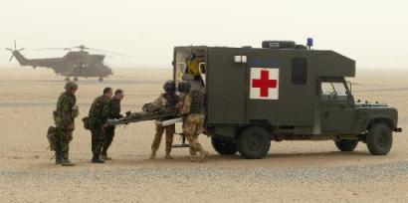
REHEARSALS
Battle Drills
Routes
CASEVAC/MEDEVAC
Communication
Scout
Guntruck
Response forces
Escort forces
Notes:
DONE BEFORE OR AFTER
BATTLE DRILLS ARE GOOD HIP POCKET TNG
SHOULD BE PART OF TIMELINE
NEXT: READY FOR A CONVOY

Slide 23

CONDUCT CONVOY
Mechanics available
Vehicles started ½ hour prior
Maintenance showdown
Commo
minimum # of vehicles, 2 radios, and a guntruck
Call in SP, CP, RP
Close the loop
Tactical Halts
Debrief upon return to S2
Notes:
CLOSE THE LOOP
CBT OFFLOAD UNDERSTANDING

Slide 24
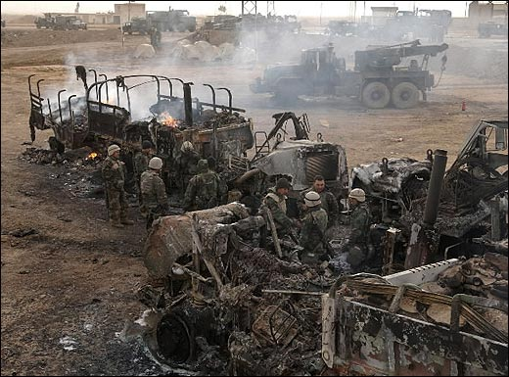
BATTLE DRILLS
Contact crew drill
Out of ammo or weapon jam
TC/AD combat battle drill
Entering/exiting the vehicle combat drill
React to contact (RPG, IED, Indirect fire)Air ATK
Convoy forced to stop (weapons fire, RPG, IED, and/or indirect fires)
Break contact
Rally points
Recovery/CASEVAC Ops
Consolidation and Reorganization
Minefield
Unplanned Halt
Herringbones
Notes:
WALK THROUGH IS BEST
TALL CHARTS WORK WELL
NEXT: REHEARSALS

Slide 25
Enemy
Tactics, Techniques and Procedures (TTP) and Recommendations
FIRST ARMY

Slide 26
REAR OF CONVOYS
Enemy forces tend to attack the rear of convoys,
  Especially convoys with a “weak” rear security element (e.g., no crew served weapon).
  Hostile forces are actively focusing on vehicles at the rear of convoys to keep the potential attack response to a minimum.
Recommendations:
  Ensure your convoy has an extremely visible force protection asset. (The more visible your convoy security is, the less likely you are to be attacked.)
  Ensure you have a strong rear security element; provide a “trail” rear security element (if available) that shadows the convoy by a few hundred meters. This force can more quickly and accurately engage hostile forces that attack our convoys from the rear.

Slide 27
BE AWARE OF CROWDS
  Attackers may use demonstrations or crowded market places as a distraction to mask their movement right before they attack with IEDs or small arms fire.
Recommendations:
  Be aware of your surroundings when near crowds
  Avoid crowded areas if possible

Slide 28
MOTORCYCLES
Use of motorcycles to attack convoys.
  Motorcycles allow for quick escape from an attack site.
  Quick and maneuverable.
Recommendations:
  Be alert for motorcycles with driver and passenger.
  Passengers may be used to attack convoy with grenades, RPGs or small arms.

Slide 29
OBSERVERS
Use of scouts/recon assets, to include photographing or videotaping of convoys. Recently the enemy has been caught utilizing periscopes to observe coalition activities.
Recommendations:
  Be observant of people observing you.
  If personnel appear to be counting the number of vehicles in your convoy, or seem overly interested in your convoy, stay alert!
  These personnel may be a scout or recon asset for a potential ambush force farther down the road, and may call/signal your approach to this ambush force.

Slide 30
BEWARE OF CHILDREN
Use of children/teenagers to conduct attacks.
  There have been several attacks on Coalition forces that have involved adolescents as either attackers or “scouts.”
  Children have also been given explosive vests to wear then sent to coalition troops.
Recommendations:
  Do not assume children are harmless!
  Be wary of children approaching your vehicles, or observing your convoy from an overpass.
  Hostile forces could be using/forcing these adolescents to conduct attacks.

Slide 31
BOTTOM LINE
Situational Awareness
Be Prepared
Communications
Keep Moving

Slide 32
QUESTIONS?

Slide 33
PE:
FIRST ARMY
You are the unit commander. Your unit has
been tasked to conduct a convoy moving
equipment and supplies. Organization of your convoy will be dependent upon the classes of materials transported.

Slide 34
FIRST ARMY
 | PE# 1 Convoy Vehicles
1. V 14 Class V | 6. V 19 GT (50 cal) | 11. V 22 Recovery
2. V 23 Recovery | 7. V 11 Class III | 12. V 10 Class IX
3. V 17 Class IV | 8. V 16 Class IV | 13. V 13 Class I
4. V 12 Class III | 9. V 21 GT (M249) | 14. V 18 Class I
5. V 15 Class V | 10. V 24 C2 | 15. V 20 GT (M19)
Set up a Convoy:

Slide 35
FIRST ARMY

